Slide 1

STUDENT REGISTRATION
FOPPS ONLINE CLASS PORTAL
https://fopps-uok.online/
FACULTY OF PHARMACY AND PHARMACEUTICAL SCIENCES SOFTSOLS PAKISTAN

Slide 2

FOPPS-UOK.ONLINE PAGE
FACULTY OF PHARMACY AND PHARMACEUTICAL SCIENCES SOFTSOLS PAKISTAN

Slide 3
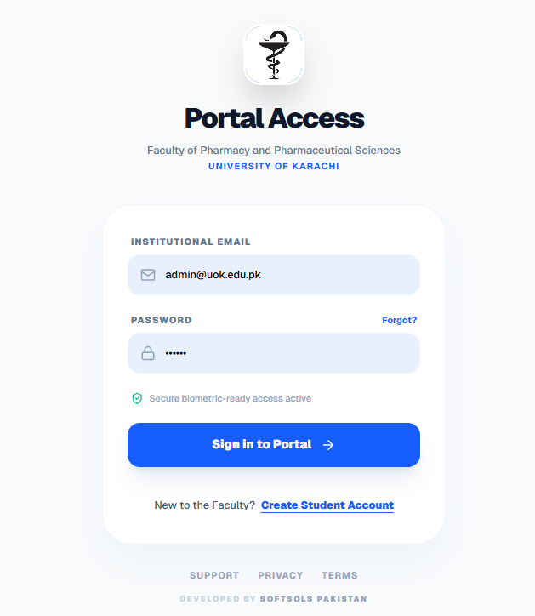
LOGIN PAGE
The Login page of Portal is Sign-In Access
Login to Portal to access by inserting:
Email Address
Password
Click Sign In to get access
FACULTY OF PHARMACY AND PHARMACEUTICAL SCIENCES SOFTSOLS PAKISTAN

Slide 4
FACULTY OF PHARMACY AND PHARMACEUTICAL SCIENCES SOFTSOLS PAKISTAN

Slide 5
PASSWORD RESET STEPS
FACULTY OF PHARMACY AND PHARMACEUTICAL SCIENCES SOFTSOLS PAKISTAN

Slide 6
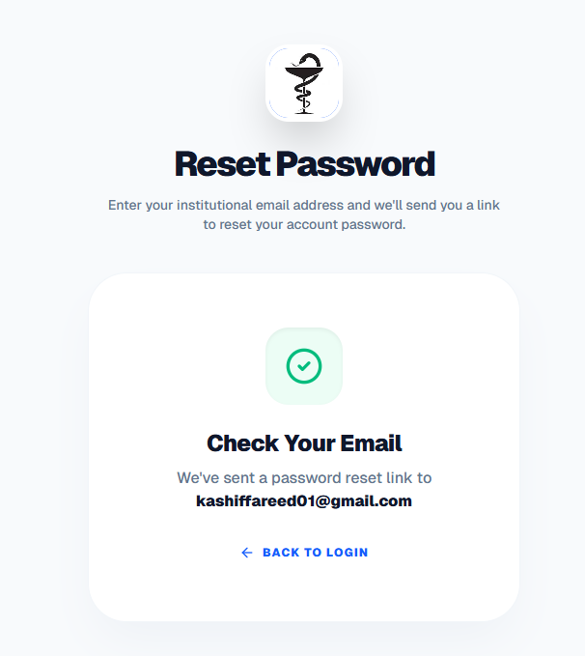
Reset Password
The confirmation message shown on screen for Password Link Sent to the respective Email Address
FACULTY OF PHARMACY AND PHARMACEUTICAL SCIENCES SOFTSOLS PAKISTAN

Slide 7
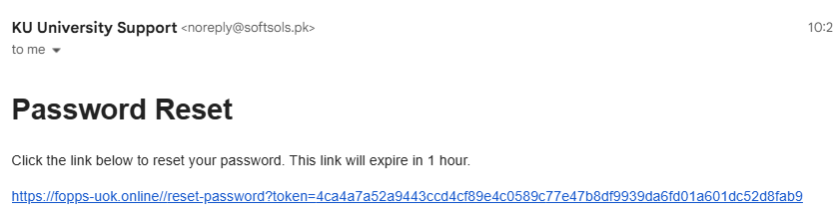
Email Received for Reset Link
FACULTY OF PHARMACY AND PHARMACEUTICAL SCIENCES SOFTSOLS PAKISTAN

Slide 8
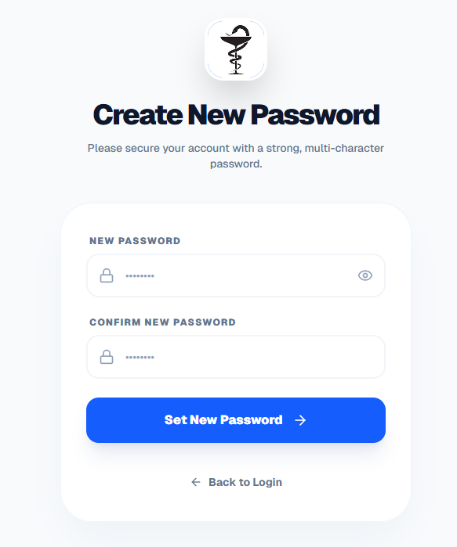
Reset Password
The confirmation message shown on screen for Password Link Sent to the respective Email Address
FACULTY OF PHARMACY AND PHARMACEUTICAL SCIENCES SOFTSOLS PAKISTAN

Slide 9
FACULTY OF PHARMACY AND PHARMACEUTICAL SCIENCES SOFTSOLS PAKISTAN

Slide 10
FACULTY OF PHARMACY AND PHARMACEUTICAL SCIENCES SOFTSOLS PAKISTAN

Slide 11
FACULTY OF PHARMACY AND PHARMACEUTICAL SCIENCES SOFTSOLS PAKISTAN

Slide 12
FACULTY OF PHARMACY AND PHARMACEUTICAL SCIENCES SOFTSOLS PAKISTAN

Slide 13
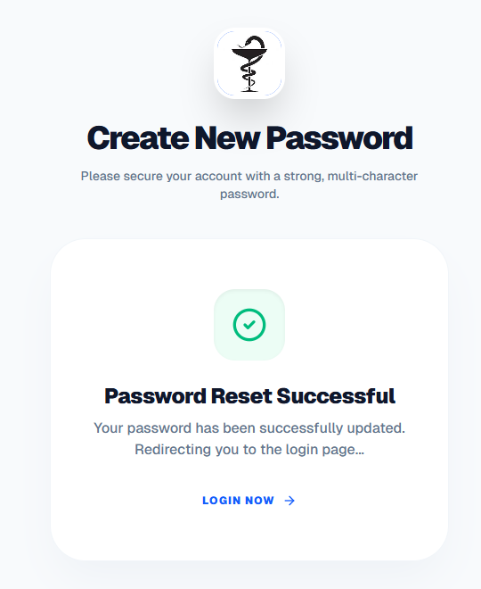
Reset Password
Confirmation on Screen about Password changed.
You will login with New Password.
FACULTY OF PHARMACY AND PHARMACEUTICAL SCIENCES SOFTSOLS PAKISTAN

